Slide 1

Agent Name Service (ANS): A Universal Directory for Secure AI Agent Discovery
The Agent Name Service (ANS) is the DNS for agent discovery
Protocol-Agnostic Design
PKI Certificate Integration
Verifiable Agent Identity
Trust Framework
Cross-Platform Interoperability
Secure Communication Enablement
Decentralized Discovery

Slide 2
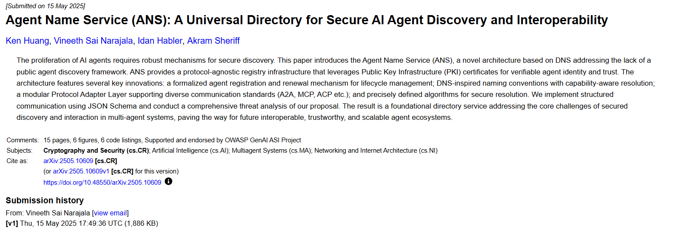
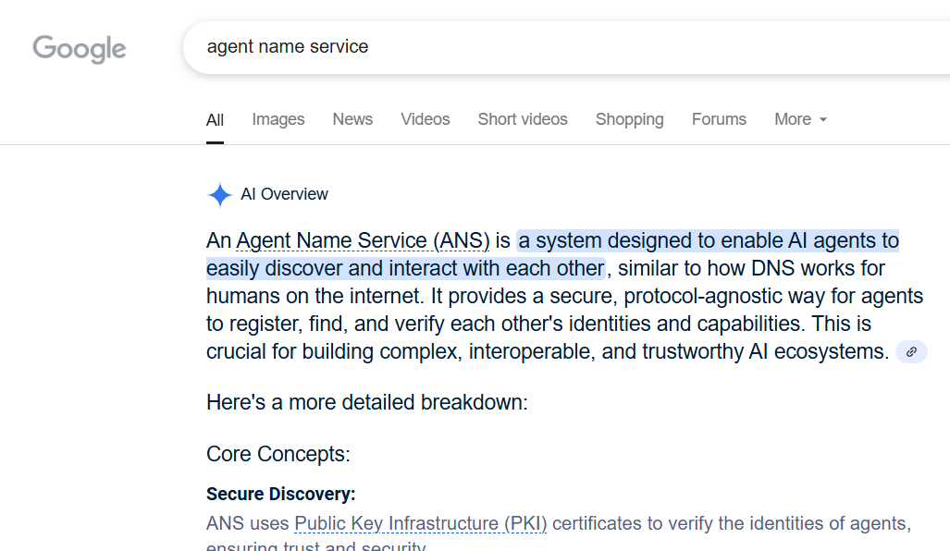
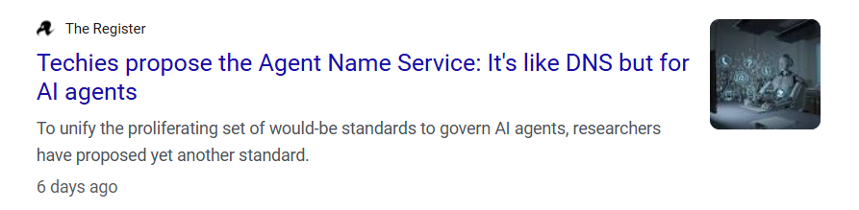

Slide 3

About Me: Ken Huang
AI Book Author
CSA Fellow
Co-Chairs of Two CSA AI Safety Working Groups
Core Member of OWASP top 10 for LLM Application
Instructor of EC-Council on Generatie AI for Cyber Security
CEO of DistrubutedApps.ai

Slide 4

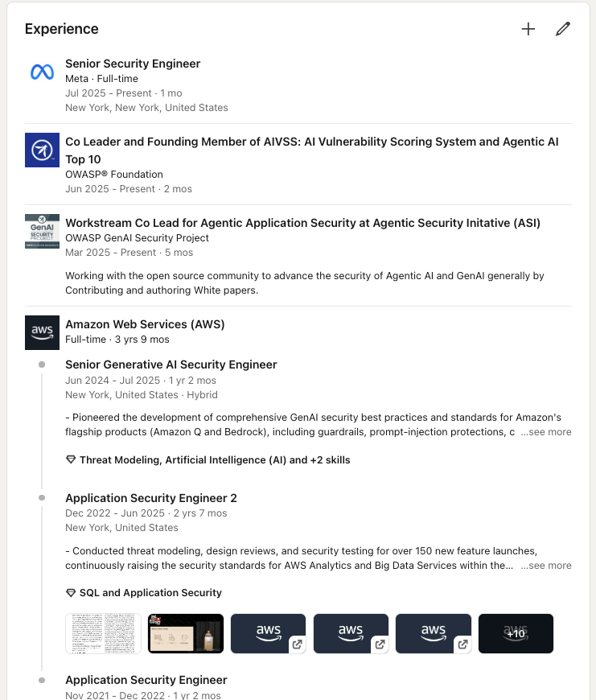

About Me: Vineeth Sai Narajala
Sr. Security Engineer @ Meta
Ex Sr. Security Engineer @ AWS
Creator/owner of vulnerablemcp.info
creator/owner of agenticsecurity.info
Researcher
OWASP AIVSS/ASI Co-lead

Slide 5


About Me: Idan Habler, Ph.D.
Ph.D. - Intersection between AI & Security
Ex-8200 | Cybersecurity
Staff AI Security Researcher @ Intuit
OWASP Secured Agentic App Co-lead
Creator of MITRE for Aviation
Co-creator of vulnerablemcp.info & agenticsecurity.info

Slide 6








Core Architecture Components
Certificate Authority
Issues and manages X.509 certificates
Agent Registry
Stores agent capabilities and credentials
Registration Authority
Verifies agent requests and manages lifecycle
Protocol Adapter Layer
Translates between protocols
The ANS architecture features several key innovations: a formalized agent registration and renewal mechanism for lifecycle management; DNS-inspired naming conventions with capability-aware resolution; a modular Protocol Adapter Layer supporting diverse standards (A2A, MCP, ACP); and precisely defined algorithms for secure resolution.

Slide 7





Agent Registration Process
Submit Registration Request
Agent submits request with metadata, protocol details, and Certificate Signing Request (CSR)
Identity Validation
Registration Authority validates agent's identity and submitted information against registry policies
Certificate Issuance
RA requests certificate from Certificate Authority using validated CSR
Registry Storage
Certificate and agent information stored in Agent Registry with timestamp

Slide 8
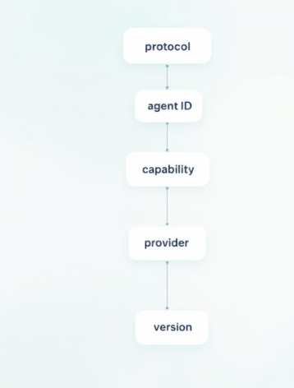
ANS Naming Structure
The ANS naming structure provides a standardized way to identify and locate agents across different protocols and platforms. This structure encodes identity, capability, and contextual metadata in a format that facilitates discovery and verification.
Formal Structure
Example
ANSName = Protocol "://" AgentID "." agentCapability "." Provider ".v" Version "." Extension
a2a://textProcessor.DocumentTranslation.AcmeCorp.v2.1.hipaa
Components
Protocol: Communication protocol (a2a, mcp, acp)
AgentID: Unique agent identifier
agentCapability: Primary agent capability
Provider: Organization name
Version: Semantic versioning format
Extension: Optional metadata (e.g., compliance)

Slide 9





Resolution Process
Parse ANSName
Break down the ANSName into Protocol, AgentID, agentCapability, Provider, Version, and Extension components
Query Agent Registry
Search for agents matching the parsed components in the registry database
Version Negotiation
If multiple matches found, select the appropriate version based on compatibility requirements
Verify Endpoint Record
Validate the agent's endpoint record using cryptographic verification and certificate chain validation
Return Endpoint
Provide the verified endpoint information to the requesting agent for secure connection

Slide 10








Protocol Adapter Layer
A2A Adapter
MCP Adapter
Parses Google's Agent2Agent Protocol information, enabling discovery based on A2A capabilities and facilitating endpoint location
Handles Anthropic's Model Context Protocol, storing tool descriptions and enabling discovery of agents offering specific MCP tools/resources
Extension Points
ACP Adapter
Allows for adding support for new protocols through modular adapter interfaces
Manages IBM's Agent Communication Protocol profiles, supporting discovery based on ACP roles and capabilities

Slide 11

Security Analysis
Threat
Risk
Mitigation Strategy
Agent Impersonation
Adversary attempts to impersonate a legitimate agent
Mandatory PKI implementation, certificate validation, digital signatures
Registry Poisoning
Injection of malicious data into Agent Registry
Strict RA validation, cryptographic signing of registry responses
Man-in-the-Middle Attacks
Modification of communications between components
Message authenticity/integrity via digital signatures, secure transport
Denial of Service
Attempts to incapacitate registry services
Distributed implementation design, rate limiting, DDoS protection

Slide 12
Demo

Slide 13





Future Directions
Prototype Implementation
Build and evaluate a working ANS prototype to validate the architecture and identify practical challenges: https://github.com/kenhuangus/ANS
Video: https://www.youtube.com/watch?v=_tO1JO_xLOk
Performance & Scalability
Benchmark resolution latency, registration throughput, and scalability under various load conditions
Advanced Cryptography
Investigate privacy-preserving techniques like zero-knowledge proofs for capability advertisement
Governance Model
Develop comprehensive policies for naming, CA/RA operations, disputes, and trust framework evolution
ANS offers a foundational infrastructure for a more secure, trustworthy, and interconnected agentic AI ecosystem. By enhancing interoperability, boosting trust and security, and accelerating innovation, ANS can become a critical enabler for the next generation of autonomous systems and secure AI marketplaces.

